Slide 1
Interventions on Food and nutrition security during Covid 19
Mr Tshimane Montoedi

Slide 2
Content
Overview
MDA Mission and Vision
MDA Current Footprint
MDA Products and Services
The Food Security Programme
Observed impact of Covid 19
MDA Response
Lessons Learnt

Slide 3
Overview
MDA is…
The MDA is a brainchild of the NUM, in response to the widespread retrenchments of 1987 in the mining sector, which, for various reasons, have continued to this day.
Our approach is informed by, and supported through:
Taking advantage of the regulatory framework and partnering with key stakeholders in advancing the socio economic agenda.
Using opportunities presented by sector charters for the benefit of former mineworkers and communities – such as : MPRD Act 28 of 2002, Mining Charter, Construction Charter and others.
A Nongovernmental organization (NPC and PBO) with a 34 year history in engaging in meaningful activities to alleviate the negative impact of joblessness to communities around South Africa, Lesotho, Swaziland and Botswana.

Slide 4
MDA Vision and Mission
Vision
Enabling sustainable livelihoods for people and communities.
Mission
To provide value added developmental solutions to targeted communities (labour sending and host) of mining, energy, metal and construction industries.

Slide 5
MDA’s current Footprint
South Africa
Lesotho
eSwatini
Botswana

Slide 6
MDA Products and services
Occupational Health & Compensation
Food Security
Enterprise Development
Skills Development
4 programme areas
Programme planning and implementation underpinned by theory of change
Implementation supported through collaboration with various stakeholders who share our vision and mission

Slide 7
MDA Food Security programme
Outcomes | Measures - Quantitative | Measures - Qualitative
Improved access to food Healthy and nourished communities Viable farming enterprises Examples of programme/project Activities: (Home gardens, Subsistence farming, Beekeeping, Wool Improvement Project, and Goat Improvement Project) | Number of participating households Number of gardens and improved breeds of livestock (goats, sheep) Quantity of production Quantity of products sold and income generated Access to agricultural services | Quality of diet (balanced diet) Health Status of families Quality and the value of vegetables, livestock and the biproducts (sheep, goats, wool) Access to markets

Slide 8
MDA Food Security programme
15 000
beneficiaries trained for home gardens p.a
100 beneficiaries supported on livestock management programmes p.a.
355
sheep farmers supported p.a. for the production of wool
150
small scale vegetable producers supported
SA: Over 45 000 assisted since 2016
SA: 151 Boergoat farmers supported since 2019
SA: Over 1000 sheep farmers supported since 2016
SA: Over 360 subsistence farmers supported since 2016

Slide 9
Impact of Covid 19
Limited contact/access to beneficiaries
Increased unemployment
Increased levels of hunger
More emergency response type interventions, e.g food parcels

Slide 10
MDA Response
Intensified its interventions ensured 61 991 beneficiaries reached 2020/21 and 2021/22 Financial years.
Notably :
1300 food vouchers worth R1000 distributed in NW, EC and FS. MDA partnered with Ubank, MIC, African Unity.
Gas stoves and filled cylinders distributed to 500 beneficiaries in the EC, FS, NW, Limpopo to improve access to safe energy and help save the costs of electricity. Partnership with SANEDI
Seeds distributed to 40 327 former and current beneficiaries to use for food production in their homes
312 subsistence farmers were assisted with seeds to boost their food production businesses
Weekly sms’es sent to 300 woolgrowers to address challenges and share information since Level 4 lockdown in 2020.
Demos on vegetable production held for smaller groups of people as per government guidelines for gatherings- resulting in 6567 beneficiaries being reached in 2020/21, and 10 187 in 2021/2.
Information sharing on various initiatives

Slide 11
Observations/Lessons Learnt
Communities hard hit by the high rate of unemployment.
Vulnerability to hunger was more accentuated
In our experience, most of the elderly passed on. Exposing families to economic vulnerability and hunger. The death rate among our beneficiaries was five times higher than what we had seen since the programme started in 2007.
Increasingly, people are turning to land/subsistence farming for livelihoods.
Climate change is fast becoming a reality and adds to the complexities of addressing food insecurity.
Therefore, intervention programmes have to be aligned to these realities

Slide 12
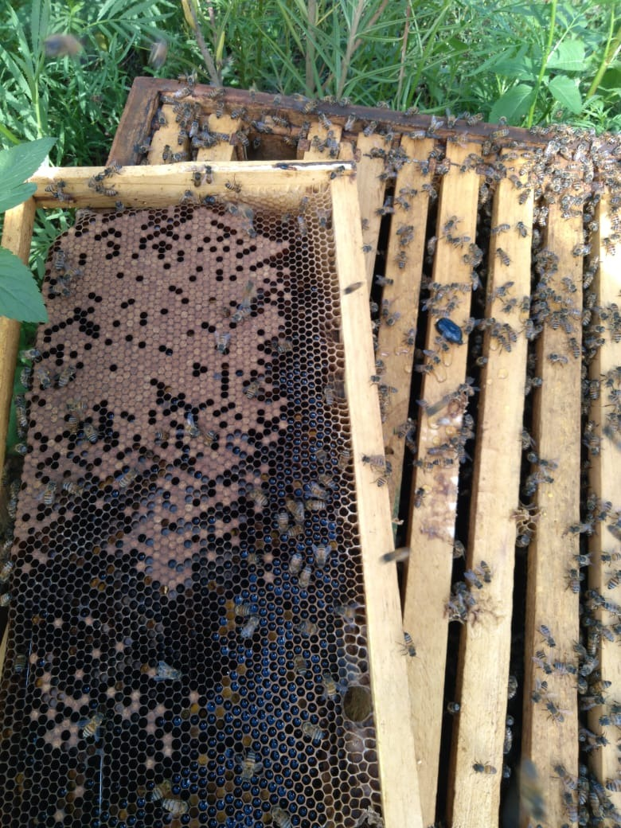
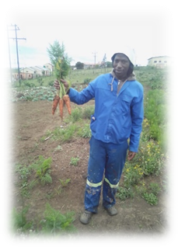
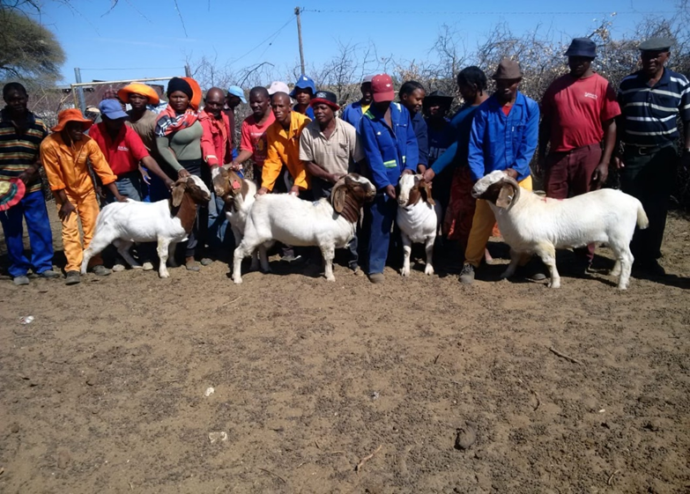
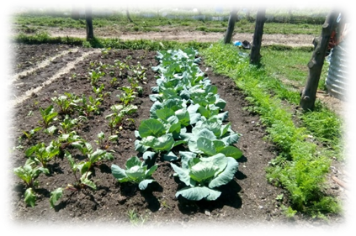
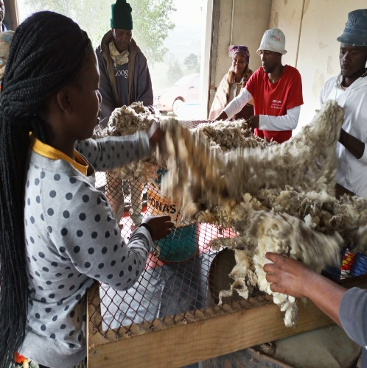
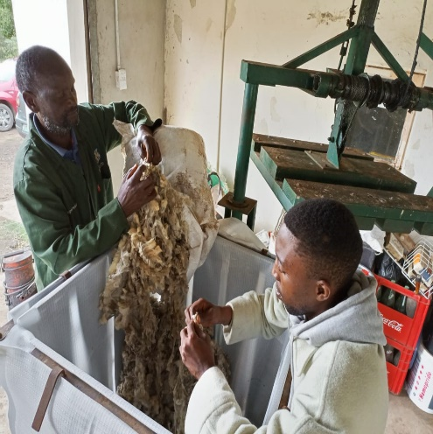
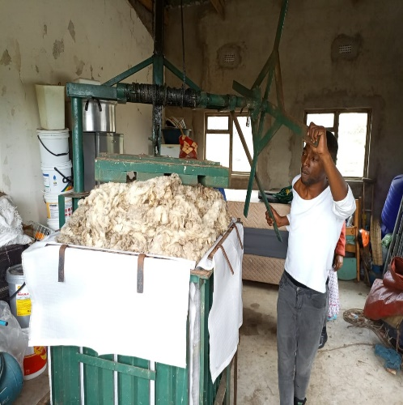
MDA Food security programme

Slide 13
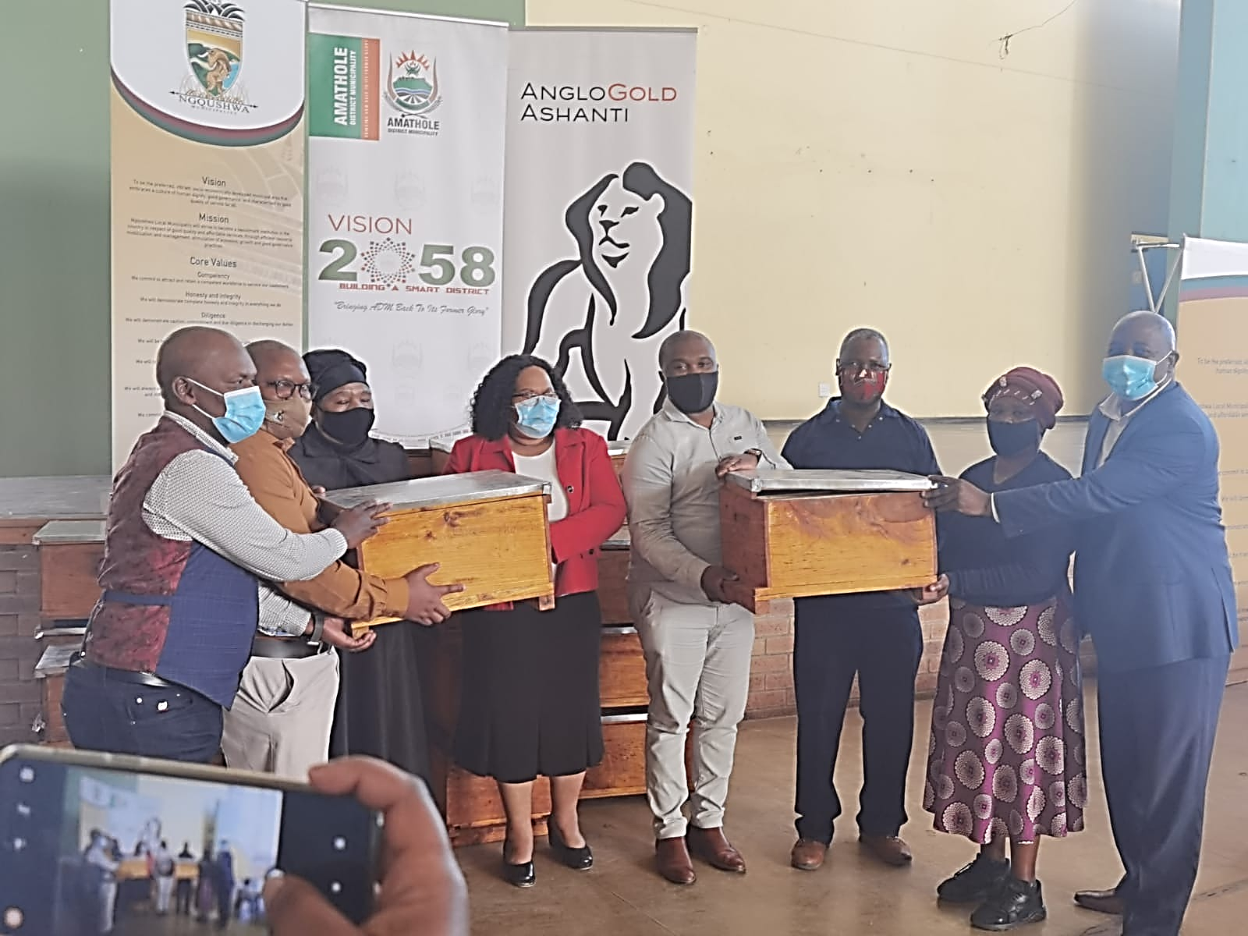
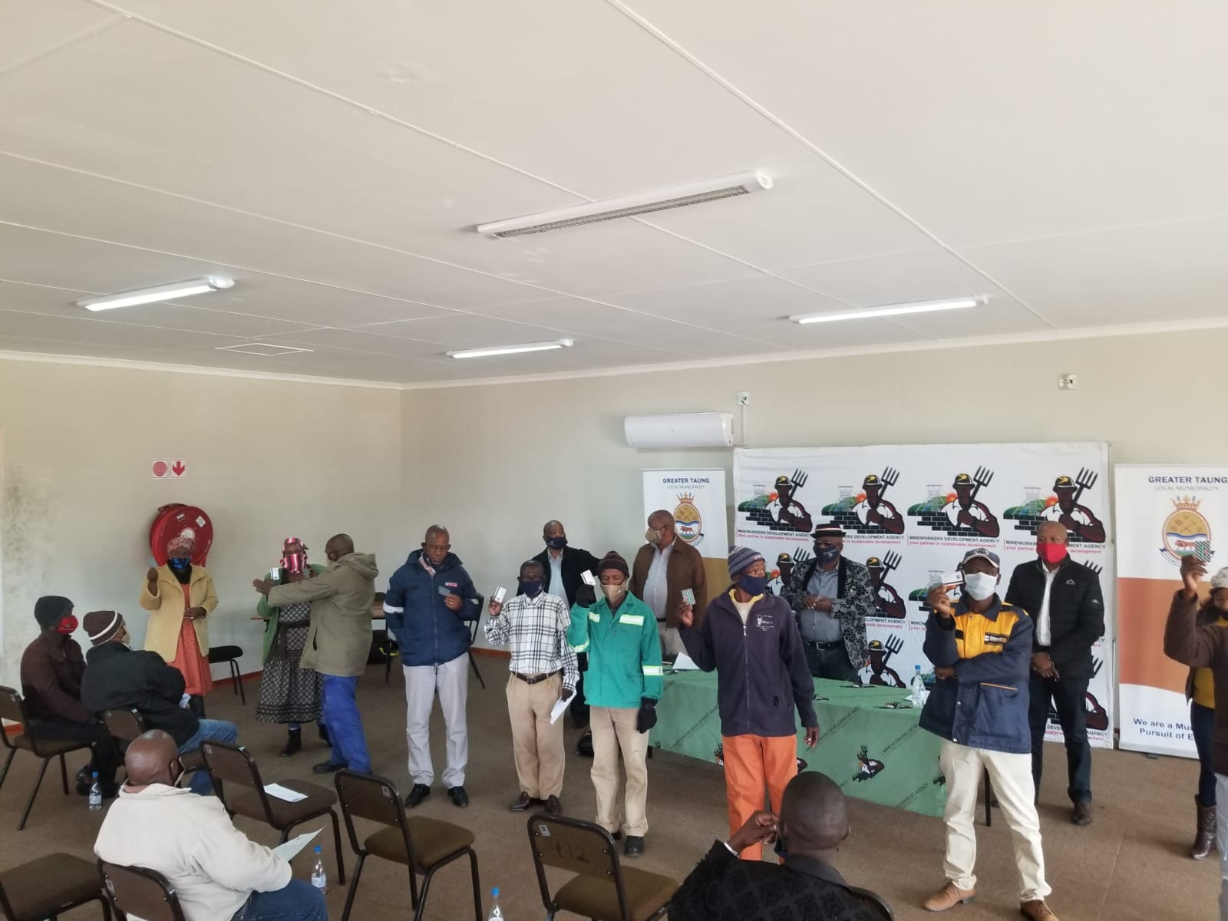
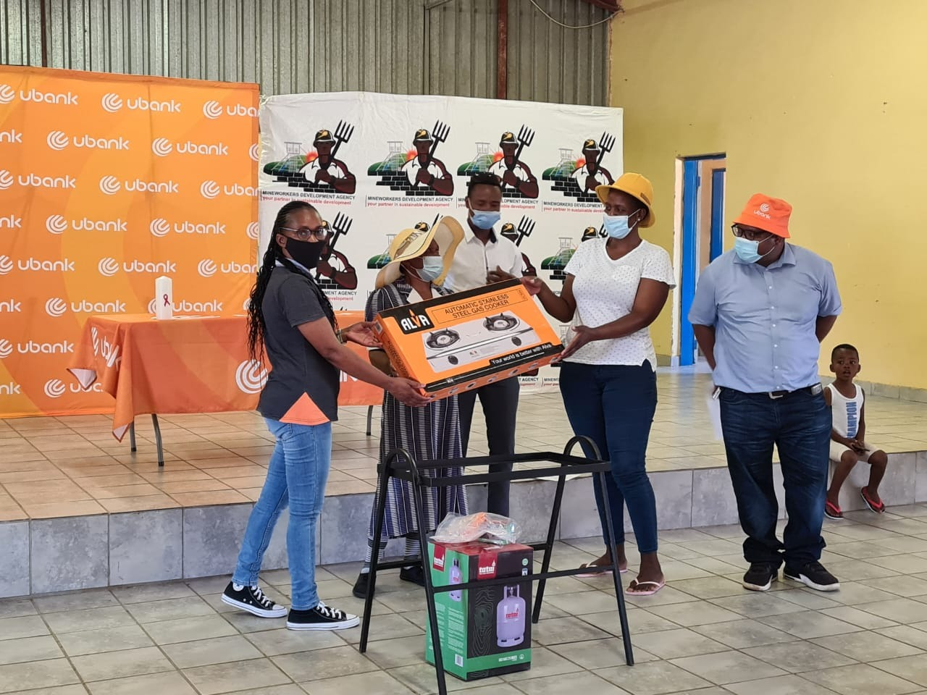
MDA Food security programme

Slide 14
Thank you
“As long as many of our people still live in utter poverty, as long as children still live under plastic covers, as long as many of our people are still without jobs, no South African should rest and wallow in the joy of freedom.” Nelson Mandela.
Tshimane Montoedi
Email: Tmontoedi@mda.org.za
cc Ntebaleng@mda.org.za
Website: https://mda.org.za

