Slide 1
DSD INTRERVENTIONS ON FOOD AND NUTRITION SECURITY DURING THE COVID-19 PANDEMIC
Webinar on Covid-19 responses and the food and nutrition security of the vulnerable populations in SA
Mr. Mondli Mbhele
Director: Food & Nutrition Security Coordination
25 August 2022

Slide 2
PRESENTATION OUTLINE
Purpose
Background and context
DSD food security interventions for COVID-19
Food relief distribution tunnels used during covid-19 period
The standardised food parcel contents
Reporting to the number of people supported
NDSD coordinated food donations during Covid-19
Food relief (R500 million) allocation to provinces
The e-voucher partnership with the Solidarity Fund
Guidelines for COVID-19 management in DSD centres
The desired community based food value chain
Lessons from the covid-19 pandemic

Slide 3
PURPOSE
To provide an overview of the DSD food relief interventions implemented during the COVID-19 pandemic.

Slide 4
BACKGROUND AND CONTEXT
How big is the problem?
23.8% of the population (14 million people) who are food insecure (experience hunger) prior to COVID-19 pandemic.
Current Provision
As at Q1 of FY2020/21 only 5 188 245 (37%) people access food through Gov’t & other partners support as part of COVID-19 food relief response
Gap analysis
14 million – 5.2 million = 8,8 million (63%) of food insecure and vulnerable people have not been reached
Provinces indicated they need R868 million to support a further 1.5 million people in the next three months
Impact of COVID 19 on the problem
StatsSA projected that 50% of the population is at risk of being food insecure
28.5 million (current provision against this is 18%)

Slide 5
DSD FOOD SECURITY INTERVENTIONS FOR COVID-19
The DSD interventions to address hunger during COVID-19 lock-down includes the following:
Provision of Social Relief of Distress (SRD);
Provision of food parcels through the DSD Feeding Programmes in partnership with the Other partners;
Provision of meals to shelters for the homeless – living on the streets;
Introduction & roll-out of the COVID-19 grant; and
DSD and the Solidarity Fund also explored mechanisms to introduce the e-food voucher
Food parcels distribution as an alternative strategy – for transitory food insecurity whilst most DSD centres were closed due to lock-down.
SRD
Food parcels
Shelters
Access to food by vulnerable groups

Slide 6
FOOD RELIEF DISTRIBUTION TUNNELS USED DURING COVID-19 PERIOD
NPOs, NGOs, CBOs, FBOs
NPC, etc
Gov’t Food Distribution

Slide 7
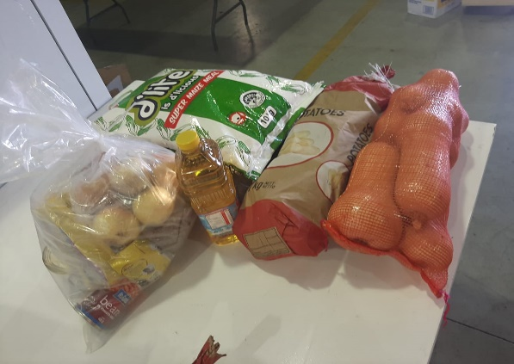
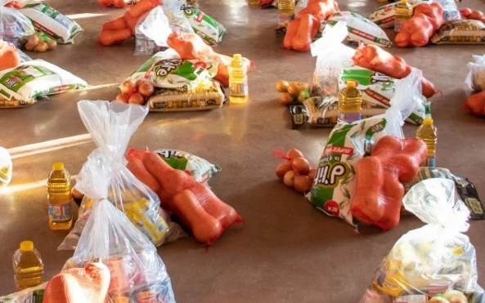
THE STANDARDISED FOOD PARCEL CONTENTS
Considerations on food parcel design:
Nnutritional value food items
Cost effective options
Ease of handle during distribution
Social acceptability
Preferably with longer shelf life & easy keeping
Essential none food items – Soap, sanitary packs, candles, soaps
Covid-19 Information leaflets for inclusion in the food packs
Hygiene needs for COVID-19

Slide 8
REPORTING TO THE NUMBER OF PEOPLE SUPPORTED
FY 2020/21 | Q1 |  | Q2 |  | Q3 |  | Q4
Province | Food Parcels Distributed | Number of people reached | Parcels Distributed | Number of people reached | Food Parcels Distributed | Number of people reached | Number of Food Parcels Distributed | Number of people reached
EC | 32 329 | 161 645 | 4 833 | 24 165 | 28 750 | 5 750 | 420 | 4 748
FS | 50 698 | 253 490 | 5 000 | 25 000 | 7 724 | 38 620 | 0 | 2 653
GP | 308 468 | 1542 340 | 196 206 | 981 030 | 89 670 | 448 350 | 672 646 | 3 363 230
KZN | 50 460 | 252 300 | 16 333 | 81 665 | 18 048 | 42 126 | 40 015 | 58 015
MP | 110 391 | 551 955 | 25 403 | 127 015 | 102 886 | 514 430 | 216 416 | 4 750
LP | 84 889 | 424 445 | 5 166 | 25 830 | 2 750 | 13 750 | 33 529 | 2 487
NC | 51 086 | 255 430 | 15 000 | 75 000 | 15 000 | 75 000 | 31 788 | 16 010
NW | 26 894 | 134 470 | 5 000 | 25 000 | 9 049 | 42 245 | 15 587 | 24 853
WC | 68 158 | 340 790 | 8 256 | 41 280 | 0 | 13 500 | 0 | 13 056
Total | 783 373 | 3 916 865 | 281 197 | 1 405 985 | 273 877 | 1 193 771 | 1 010 401 | 3 489 802
GRAND TOTAL |  | Number of Food Parcels Distributed = 2 348 848 Estimated Number of people reached = 10 006 423 @ (5 People/Household)

Slide 9
NDSD COORDINATED FOOD DONATIONS DURING COVID-19
Donor | Type of donation | Total Amount donated
1. Solidarity Fund | Food parcels (58 750) | R23,5 million
2. Old Mutual | Food parcels | R5,6 million
3. Unilever | Hygiene materials – soaps & tea | Not confirmed
4. Spar-Group (Pty) Ltd | 8 000/month x 3 months - Food parcels | R13 million
5. CJC LDS Church | 30 000 Food parcels | R24 million
6. SA Sugar Association | Selati 5kg sugar (R282.95 per 4x5kg baler) 388 balers or 1 552 bags | R110 000
7. Khula Milling | 3 000 X 10kg (30 tons) for FS, GP & Limp Provinces | R237 250

Slide 10
NDSD COORDINATED FOOD DONATIONS DURING COVID-19
Donor | Type of donation | Total Amount donated
8. Majesty Oil Mills (Pty) Ltd | Soya Beef Stew (500g x 250) Soya Chicken Mince (500g x 250) Soya Soup (500g x 250) Soya Bolognaise Mince (500g x 250) | Not confirmed
9. UNDP | Bottled hand soaps | Not confirmed
10. SAB | 55,000 Meals | Not confirmed
11. Procter and Gamble | 10,000 boxes of Pampers nappies 10, 000 boxes of Always Sanitary towels | Not confirmed
TOTAL |  | R66 447 250.00

Slide 11
FOOD RELIEF (R500 MILLION) ALLOCATION TO PROVINCES
Limpopo : R57 848 000
Mpumalanga : R40 943 000
North West : R34 846 000
North Cape : R13 228 000
Gauteng : R104 216 000
Western Cape: R51 281 000
Free State : R27 853 000
Notes:
The allocation is per the equitable share allocation set by the National Treasury
Provinces were consulted and informed about the allocation and the parameters for use of the funds
Funds have to be used by Q4 of FY 2020/21
KwaZulu Natal: R103 506 000
Eastern Cape: R66 279 000

Slide 12
Guide to provinces on the use of funds
The DSD guided that Provinces use the R500million allocated in the equitable share in the following manner:
To increase the capacity to provide food relief to more people using the feeding programmes – CNDCs & other CBFPs
Provide food parcels to households not serviced by any of the current network of DSD feeding programmes;
Distribution of food vouchers to far flung areas not serviced by the Department; SASSA and other government departments

Slide 13
TRANSITION FROM FOOD PARCELS TO ELECTRONIC & PHYSICAL VOUCHERS
Pre-COVID
During COVID
(Current Strategy)
Beyond COVID
(Revised Strategy)
Strategy was providing cooked meals through centres
Strategy changed to providing food parcels & R350
Strategy provide hybrid approach including Cash and e-vouchers
Delivery Mechanisms
Use of PFDC & CNDCs
Funding to – ECD, Luncheon clubs, DIC/HCBCs
SRD
Delivery Mechanisms
NPOs as Implementing Agents
Business,
NPC,
FBO
Donors
Public/individuals
Delivery Mechanisms
Use e-voucher System
Use cash transfers
Electronic systems and EFT utilised for the process
9

Slide 14
E-VOUCHER PARTNERSHIP WITH SOLIDARITY FUND
DSD received the 1st donation of R23,5 million worth of food parcels during the 1st wave of COVID-19 and supported a total of about 60 000 households.
The Solidarity Fund further asked to donate 20 000 food vouchers worth R17 million to DSD.
DSD could not roll-out this donation to all the provinces. Two provinces that were most needy were identified to pilot the roll-out of the voucher system – Northern Cape and North West.
DSD then signed the MoU and accepted the once off donation to be implemented with the Solidarity Fund.
The 1st 16 000 beneficiaries were paid before Easter holidays and the last 4 000 will be paid by the end this week to conclude the payment of 20 000 vouchers allocated by the Solidarity Fund.

Slide 15
E-voucher Pilot Project in NC & NW Provinces
The Solidarity Fund donated 20 000 each worth R700 e-vouchers worth R14 million to DSD for piloting the use of e-vouchers system.
DSD could not roll-out this donation to all the provinces. Two provinces that were most needy were identified – Northern Cape and North West.
DSD then signed the MoU and accepted the once off donation that was implemented by February 2020.
The Solidarity Find used the Implementing Agents – Tshikululu to pilot the use of e-voucher for food relief.
About 12 258 of the 16 735 issued vouchers were successfully redeemed through this pilot study = 73% success rate. This however, is about 61% of the total allocated number of vouchers.

Slide 16
E-voucher Pilot Project in NC & NW Provinces
 | Target | Vouchers issued | Redeemed | %
Northern Cape | 10 000 | 9 817 | 7 985 | 81 %
North West | 10 000 | 6 918 | 4 273 | 62 %
Total | 20 000 | 16 735 | 12 258 | 73%
Shortfall |  | 3 265 | 3 742 | 20%
Challenges:
SF to confirm details of voucher redemption points in each of the provinces outlining :
Builders / Cambridge Food / Checkers / Game / House and Home / Makro / OK Furniture / OTT Collect approved sites / Pick n Pay / Rhino / Shoprite
Use of cell phones for voucher redemption – sharing of phones
Suspicion of scam and deletion of vouchers
Mobilisation and awareness by beneficiaries
None existence of electronic database for indigents in Provinces & Database format:

Slide 17
GUIDELINES FOR COVID-19 MANAGEMENT IN FEEDING CENTRES
The following steps are undertaken by DSD to limit the spread of Covid-19 in DSD feeding centres:
Developed the guidelines for COVID-19 management in DSD centres;
Virtual field testing of the guideline and training of 1 233 officials & centres’ personnel
Printing 1 000 copies to be distributed to provinces – Provinces to indicate number of copies needed.
Assessment of compliance – trained officials & SHOs to continuously assess the centres’ compliance to guidelines

Slide 18
THE DESIRED COMMUNITY BASED FOOD VALUE CHAIN
CHARACTERISTICS
Agro-processing & Distribution – public procurement
Nutritious food to PVMs
HH behavior change communication
Food production & aggregation
Local food production
Agro-processing of aggregated local produce
Affordability of food by the poor
Procurement of food by public programmes
PFDCs distribute food to CBFPs and foster LED
Poor and vulnerable access nutritious food
Public make informed food choices – through nutrition education (HHs, kids in schools & etc)

Slide 19
LESSONS FROM THE COVID-19 PANDEMIC
Transformation of conventional service delivery strategies – Digital migration, e-voucher solution to replace food parcels, etc.
There is a need to strengthen resilience of household livelihoods
There is need to increase coverage and integration of the social protection interventions
Develop a National Integrated Social Protection Information System / indigent registry to streamline targeting, means testing and beneficiary targeting
Consideration must be given to foreign nationals living in SA (legally and illegally)
There is a need to focus on the engagement with the public, CSOs – FBOs, etc. and Business :
Coordination of response interventions
Donor coordination

