Slide 1
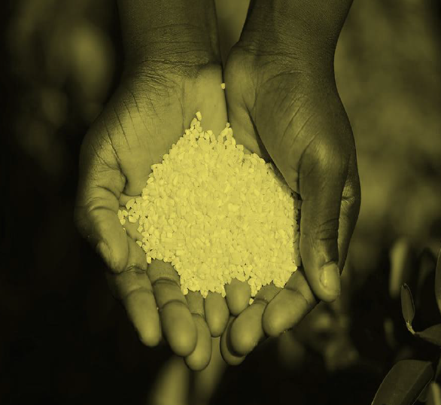


COVID-19 RESPONSES AND THE FOOD AND NUTRITION SECURITY OF
VULNERABLE POPULATION GROUPS IN SOUTH AFRICA
HSRC-NDA Policy Dialogue
Matume Maila
25 August 2022
Inclusive Economic Development (IED)
Climate, Land & Agri-food Systems (CLAS)

Slide 2
Presentation Outline
Who are the people that we interviewed?
What did we learn from the interviews we did with the beneficiaries?
What is the distribution of food assistance?

Slide 3
Methodology: Planned and Realised
Methodology-Mixed methods study
Four techniques involved: literature and documentary reviews, secondary data analysis, key informant interviews, and a survey of beneficiaries.
Beneficiary Survey
Simple Random Sampling
Targeted population – Recipience of food assistance (people visiting CNDS) – Food parcels & Food vouchers
Calculated sample size – 384; Realised - 502
Telephonic and face-to-face interviews

Slide 4
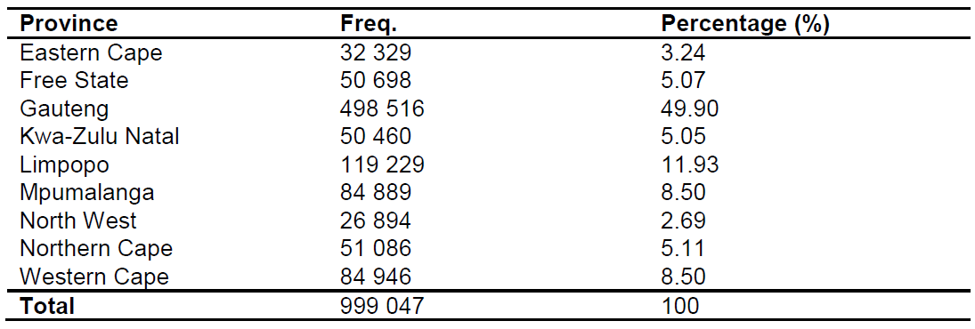
Methodology: Planned and Realised Cont.
Table 1: Number of beneficiaries interviewed per province

Slide 5
Methodology: Planned and Realised Cont.
Gauteng accounts for a lagger proportion of the population represented by the sample (50%) – why?
Eastern Cape (Poorest province) - accounts for least number of the population represented by the sample (3%) – why?

Slide 6
Beneficiary Survey Results
Food security vs food insecurity.
Food access.
Income distribution.
Amount of money spent on food.
Calculations of household income per month @ADEQ.
Food spending per ADEQ.
ADEQ vs Household size.
Household income per ADEQ in 2020.

Slide 7
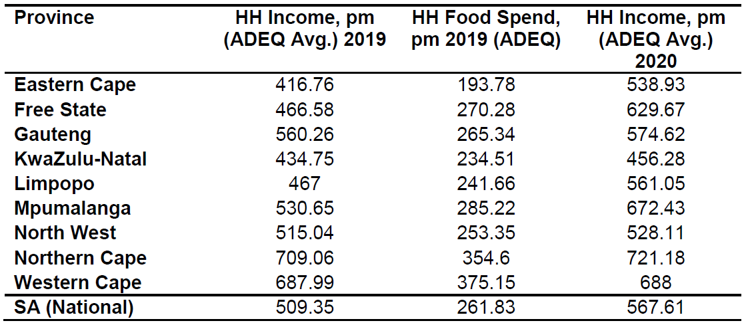
Beneficiary Survey Results Cont.
Table 2: Monthly income and food spending by ADEQ, averages for 2019 and 2020

Slide 8
Beneficiary Survey Results Cont.
Eastern Cape has a low HH Income, pm (ADEQ Avg.) 2019.
Northern Cape and Western Cape have a high HH Income, pm (ADEQ Avg.) 2019.
Eastern Cape has low HH Food Spend, pm 2019 (ADEQ).
Northern Cape and Western Cape have a high HH Food Spend, pm 2019.
Mean Avg. in 2020 is higher than mean Avg. in 2019 - increase in income.
Why are they better off during the pandemic?.

Slide 9
Beneficiary Survey Results Cont.
Food poverty line (FPL) 2019 – R561
Lower-bound poverty line (LBPL) 2019 - R810
Income distribution, food spending share vs food poverty line.

Slide 10
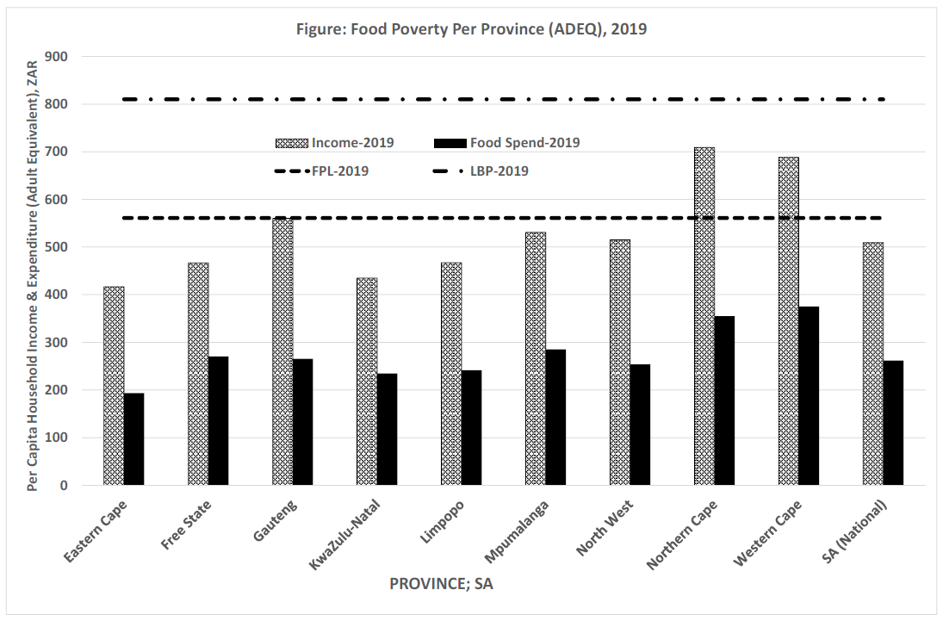
Beneficiary Survey Results

Slide 11
Beneficiary Survey Results Cont.
Beneficiaries are below food poverty line.
High concentration of poverty among beneficiaries.
Desperate for social assistance.
They should have all received social assistance.

Slide 12
Types of assistance received
The various types of assistance were provided to vulnerable households during the pandemic.
Types of assistance perceived: Food parcels, Food vouchers, Social grant, UIFTERS, and Covid Relief Grant (SRD).

Slide 13
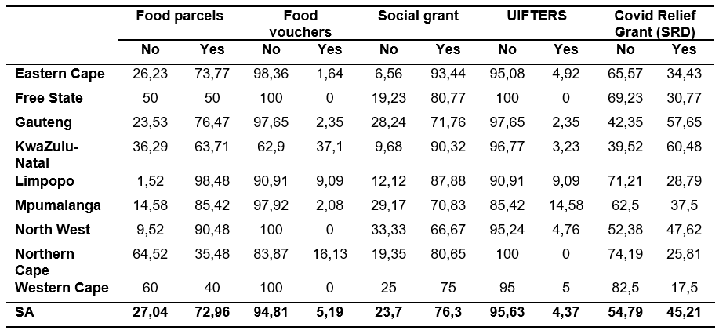
Types of assistance received Cont.
Table 3: Type(s) of assistance received during the lockdown

Slide 14
Types of assistance received Cont.
Food parcels and social grants - main interventions received by beneficiaries.
Usefulness of Covid-related support.
Overlap between receiving food parcels and other form of assistance.

Slide 15
THANK YOU!

