Slide 1
Policy Brief Insights: “Vulnerability to hunger during the pandemic”
NDA Policy Dialogue
Peter Jacobs, PhD
Inclusive Economic Development (IED), HSRC
25 August 2022

Slide 2
Policy Questions & Messages
Crises like Covid-19 demand proactive and agile food and nutrition security assistance
Societies increasingly worry about ‘cost of living crises’ – global & local (theme of yesterday’s national strike)
Critical Questions:
  How can policy actors take on board learning from the ‘Covid-induced hunger crisis’ to protect vulnerable people?
  How can food and nutrition assistance schemes be improved?

Slide 3
Social Assistance - 2020
Policy Brief invites deeper reflections on hunger experiences and policy actions during the first 2 waves of the pandemic in 2020.
Scaling up of direct food assistance (food parcels and vouchers) and other forms of cash social assistance

Slide 4
Social Assistance Snapshot
Analysis Categories | Food parcels | SRD-R350 | TERS- UIF | Traditional Conditional Cash Grants
Intervention purpose | Food-based support to households living below the food poverty line and inadequate access to food | Social relief assistance to persons living in poverty and without any other income protection. | Wage subsidy for workers on temporary lay-off during the Covid-19 the pandemic | Aims to provide support to those living in poverty and in need
Primary benefit | Direct food parcels comprising basic food basket items. | Cash transfer at the value of R350 per month for each eligible person. | Cash transfer to eligible worker or employers. | Cash transfer every month; value depends on cash grant conditions.
Recipient numbers | 3.2m | 10.5m | 5.7m | 18.4m
Source: HSRC Study (2022)

Slide 5
Social Assistance - 2020
Policy Brief invites deeper reflections on hunger experiences and policy actions during the first 2 waves of the pandemic in 2020.
Scaling up of direct food assistance (food parcels and vouchers) and other forms of cash social assistance

Slide 6
Poverty Targeting?
Policy puzzle: how to distribute limited public resources to lift the maximum number out of poverty?
Living standards boundary – money metric poverty lines (StatsSA annually adjusted)
  Food Poverty (FPL)
  Lower Bound (LBP)
  Upper Bound (UBP)
How to capture “vulnerable groups” making ends meet slightly above the line?

Slide 7
Comparing FGT (α=0) poverty shares (%) by Province, 2019 & 2020
Province | Poverty Rate (% Headcount)
Province | 2019 | 2020 | Change Direction
Eastern Cape | 0.72131 | 0.65574 | ↓
Free State | 0.61538 | 0.57692 | ↓
Gauteng** | 0.65882 | 0.65882
KwaZulu-Natal | 0.79839 | 0.78226 | ↓
Limpopo | 0.72727 | 0.65152 | ↓
Mpumalanga | 0.72917 | 0.70833 | ↓
North West | 0.66667 | 0.57143 | ↓
Northern Cape** | 0.54839 | 0.61290
Western Cape | 0.50000 | 0.47500 | ↓
South Africa (National) | 0.66090 | 0.64381 | ↓

Slide 8
Income Inequality & Food Access
Quintiles | Income, pm (ADEQ Avg.) 2019 | Income, pm (ADEQ Avg.) 2020 | Food Spend, pm 2019 (ADEQ) | Food Spend Share (%)
Bottom Quintile | 163.9 | 282.24 | 147.02 | 87,1%
Qnl2 | 295.77 | 366.41 | 220.55 | 70,1%
Qnl3 | 505.99 | 614.74 | 291.7 | 55,6%
Qnl4 | 494.23 | 466.02 | 257.19 | 50,2%
Top Quintile | 932.37 | 750.51 | 405.85 | 43,1%
Overall | 469.77 | 494.04 | 261.87 | 61,5%

Slide 9
Food Assistance Experiences
First, a food parcel recipient - or their family members - often obtained more than one type of food-based support.
Second, the provincial distribution of food-based assistance was uneven- due to the agency of hungry people to actively search for food assistance, institutional capacity of provincial departments or the heightened activism of non-state relief agencies contributed to this situation.
Third, while access to cash assistance correlates positively with food assistance, it is not immediately evident what could be driving it.

Slide 10
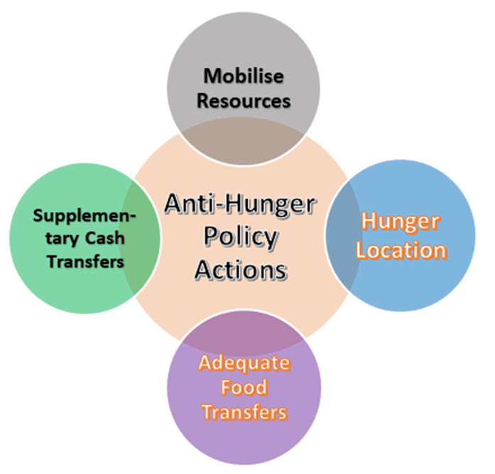
Urgent Policy Actions
Mobilise enough resources for the rapid delivery of social assistance
Identify and locate hungry people
Deliver and distribute adequate food to the needy
Provide supplementary cash transfers where necessary and feasible

