Slide 1
PERSPECTIVES ON CURRENT NPO FUNDING MECHANISMS IN SA
NDA WEBINAR
MR.FP NETSHIPALE
DDG :COMMUNITY DEVELOPMENT
26 AUGUST 2021

Slide 2
PRESENTATION OUTLINE
Purpose
Background
Registered NPO in SA
NPO funding contextual overview in south Africa
Economic contributions of NPO in SA
Funding Mechanisms for NPOs in SA
Funding of NPO in DSD sector
Approaches to achieve better NPO funding in SA
Conclusion

Slide 3
PURPOSE
The purpose of the presentation from the NPO regulator point of view is to share perspectives in the NPO funding mechanisms in south Africa and also outline DSD funding mechanisms to support the Non-Profit Organizations rendering social development services.

Slide 4
BACKGROUND
In SA Non Profit Organisations (NPOs) play a vital role in serving social, economic, social and environmental causes in communities.
NPOs Promote community empowerment and contribute to building healthy communities.
NPOs contribute to socio-economic stability and do participate in employment creation however; the past two years has been a tumultuous time for NPOs with more demand on their services than ever before as a result of Covid-19.
Funding is a major obstacle that NPOs in SA face due to the global economic crisis.
Due to reduced private and corporate donor funding, many NPOs have sought more funding from government to keep afloat, ultimately creating increased competition among NPOs for government funds.

Slide 5
BACKGROUND (CONT…..)
The Department of Social Development administer the NPO Act 97 of 1997 which prescribes the functions of the directorate with regards to the Non profit organisations
The NPO Directorate was established to deal with the regulatory matters of all non-profit organisation as stipulated in section 1 and 5 of the NPO Act.
The main object of the NPO Act is “to encourage and support Nonprofit Organisations in their contribution to meeting the diverse needs of the population of the Republic by-
  Creating an environment in which NPOs can flourish
  Establishing an administrative and regulatory framework within which NPOs can conduct their affairs
  Encouraging NPOs to maintain adequate standards of governance, transparency and accountability, and to improve those standards
  Creating an environment within which the public may have access to information concerning registered organizations
  Promoting a spirit of co-operation and shared responsibility within government, donors and other interested persons in their dealings with nonprofit organisations

Slide 6
Registered NPO by Sector

Slide 7
Registered NPO by Legal Form

Slide 8
NPO FUNDING – CONTEXTUAL OVERVIEW
The NPO Act legislation serves mainly-
  To provide a Registration Facility for organisations that are nonprofit in orientation and are not organs of the state;
    Enables an organisation to establish itself as body corporate.
    Regulates how this entity operates and account broadly to its community and the public. (promote public trust)
Chapter 2, Section 3 stipulate the state’s responsibility to nonprofit organisations with regards to funding: it state that
“ Within the limits prescribed by law, every organ of state must determine and co-ordinate the implementation of its policies and measures in a manner designed to promote, support and enhance the capacity of nonprofit organisations to perform their functions.”

Slide 9
ECONOMIC CONTRIBUTIONS OF NPOs IN SA
In the “Review of Philanthropy Report within SA Phase II”, in the year 2017 NPO economic contribution to GDP was 3, 2% per annum.
The total income of the NPOs was estimated to be more than R12, 5 billion to which the South African government contributed a substantial amount in the form of subsidies and other forms of grants, followed by the private sector through its corporate social investment programmes.
Other forms of funding sources were derived from investments, membership fees and sales
The sector provides additional services;
  Value of 1 million Volunteers contribution to the country’s development about R12 billion.
  Employed people estimated to be 1, 3 million which is extrapolated from the base of 1 million in 2010.

Slide 10
FUNDING MACHANISMS FOR NPOS IN SA
The NPO Act prescribes that all organ of state must promote, support and enhance the capacity of non-profit organisations to perform their functions
  Government Departments and state entities must provide funding to the non profit sector to implement government policies, strategies and to uplift the communities in the fight against poverty and development.
Countries Private sector or business provide funding to the non-profit organisations for variety of objectives, and these includes
  Mines, retail sectors, individual businesses and sureties
International donors coordinated by National Treasury provide the necessary funding in country to leverage financial burden in a country
In SA government provide guidance for the government funding through the PFMA
Other funders doe it as they wish, which indicate a gap that must be played by government and the business partnership in addressing poverty and development

Slide 11
Funding of NPO in DSD Sector
In 1936 a welfare department was established in the then republic of south Africa with its service delivery being the non profit sector
Historically, social services have been the joint responsibility of DSD and the NPO sector
The critical role that the NPO sector has played over the years in service provision is acknowledged by DSD.
The department like other government departments fund NPOs that are registered for social services to deliver social services in all nine provinces
Each department fund NPOs using it own policy that guide their approach in line with PFMA and SCM principles
The Department has implemented the policy of financial awards policy that was amended as a guide to fund NPOs in the sector

Slide 12
CURRENT ALLOCATION TO NPO (2021/22)
Provinces: Non Profit Institutions | 2021/22
 | Main
 | Appropriation
Eastern Cape | 646 866
Free State | 555 413
Gauteng | 2 561 266
KwaZulu-Natal | 1 163 360
Limpopo | 540 802
Mpumalanga | 657 185
Northern Cape | 237 833
North West | 360 135
Western Cape | 1 430 031
Total | 8 152 891
Programmes: Non Profit Institutions
Programme 2 : Social Welfare Services | 2 110 929
Programme 3 : Children and Families | 4 675 844
Programme 4 : Restorative Services | 848 448
Programme 5 : Development and Research | 517 670
Total | 8 152 891

Slide 13
ALLOCATIONS- TRANSFERS-NPOS PER PROVINCE

Slide 14
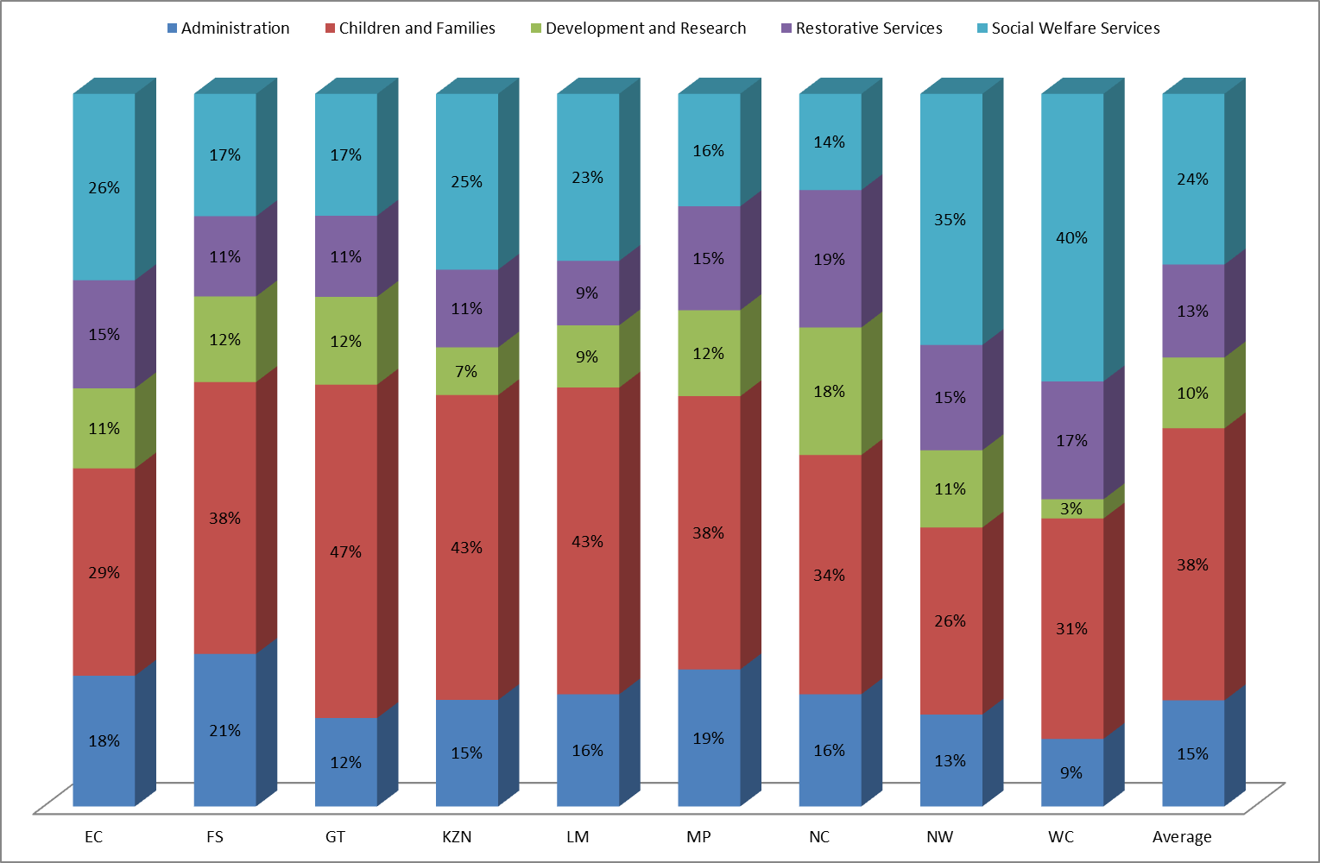
DISTRIBUTION OF ALLOCATION ACROSS PROGRAMMES
Notes:
The largest proportion 38% continues to be spent on Children and families followed by social welfare and then Admin.
All provinces spend the largest proportion of their budget on Children and Families, with the exception on WC and NW who spend the largest portion on Social Welfare Services
GT spends the largest proportion on children and families, followed by LIM and KZN
NC spends the largest proportion on Restorative services and development and research.
Admin % particularly low in GT and WC. FS highest %
Do high proportions reflect the priority in that province?

Slide 15
NPOS TRANSFERS DISTRIBUTION TO PER PROGRAMME

Slide 16
GROWTH OF TRANSFERS TO NPO’S PER FINANCIAL YEAR
R’000

Slide 17
GROWTH OF TRANSFERS TO NPO’S PER PROGRAMME OVER FINANCIAL YEARS

Slide 18
Funding of NPO in DSD Sector (CONT….)
The importance of the partnership between DSD and the sector is informed by the constitutional, legal and international obligations as well as policies and programmes that are central to the mandate of the department.
These, collectively contribute immensely towards the creation of an enabling environment for the effective delivery of developmental social services.
DSD policies and legislative frameworks has created a conducive climate for the Department of Social Development to achieve its mission, particularly regarding the equitable distribution of resources.
The White Paper for Social Welfare (1997), continues to serve as an overall guide for the delivery of developmental social welfare services that are accessible and equitable for all South Africans and central to this, is the an effective partnership between DSD and the NPO sector.
This partnership remains critical towards the realization of the key priorities of the Department and Government as a whole

Slide 19
Funding of NPO in DSD Sector (CONT….)
Government is working with relevant stakeholders in ensuring the efficient and effective provision of services to individuals and communities.
It is on this basis that government very often provides funding annually in the form of transfer payments to entities that are outside of government (NPOs) as provided for in terms of section 38(1)(j) and (k) of the Public Finance Management Act (Act No. 1 of 1999) (PFMA).
Transfers to non-profit organisations (NPOs) are particularly important towards realising service delivery objectives in the various social sectors.

Slide 20
APPROACHES TO ACHIEVE BETTER NPO FUNDING IN SA
NON-PROFIT ORGANISATIONS
Maintaining Public Trust
NPOs must be transparent, responsible and accountable in the public eye
Ensuring compliance
NPOs must be Compliant with all legal prescripts
Self Regulations
The NPO sector to organise themselves and regulate themselves, holding each other accountable
3. Strong Partnerships in Communities
Another way to revive the partnership is to make friends in the corporate world through CSI.
Forming long-term, CSI-NPO partnerships which could be a way to establish a funding channel with clear long-term outputs.
4. Public organisation status
NPOs are more likely to become financially sustainable over time if they can also access tax concessions, (such as section 18A certificates)
GOVERNMENT
Establishment of NPO registration and Compliance monitoring as a regulator ( Entity)
Develop better mechanism to ensure adequate funding of the NPO sector by the state
Dedication of certain government funds for the support of NPOs to deliver services
Development of an NPO funding policy for the country in collaboration with private sector

Slide 21
CONCLUSIONS
The current situation in the country with regards to funding of the NPO sector point to the fact that the sector is hard done by as they are severely underfunded.
The current situation in the country as articulated in the White Paper review report, point to the fact that government and Social development services are underfunded by R9,2 billion in 201/19 financial year.
The dwindling south African financial fiscus ( Budgets) is also major concerns as government department budgets are continuously reduced each year
Establishment of partnership between government and the NPO sector, businesses and the NPOs sector in addressing social challenges is paramount as it could address the NPO resourcing challenges
Central to this partnership, is to define the partnership that is based on mutual understanding in the provision of services and the uplifment of our communities
The current partnership with the NPO sector is based on financial support and not on alleviating communities challenges
The current sector realities demand that:
  Government Department and DSD get funded according to its mandate and costed policies and legislations including the norms and standards,
  Funding model of services be reviewed to ensure that there is equitable provision of services especially to historically disadvantaged communities.
Private sector and donor to come on board and fund the NPOs in the delivery of services to communities

Slide 22
Thank you!

